Slide 1

Seasonal Air Quality Index (AQI) Category Prediction Using Classical Supervised Machine Learning Models
Course Name: CSE-208: Machine Learning
Submission Note:
Submitted towards the partial fulfillment of completion requirements for CSE-208
Team Members :
Farhan Akhlaq (SAU/CS/DMTECH(CSE)/2024/09)
Karthik Baurai (SAU/CS/BTECH(CSE)/2024/38)
Misbah Ul Islam (SAU/CS/BTECH(CSE)/2024/44)
Mukund Prasad (SAU/CS/DMTECH(CSE)/2024/13)

Slide 2
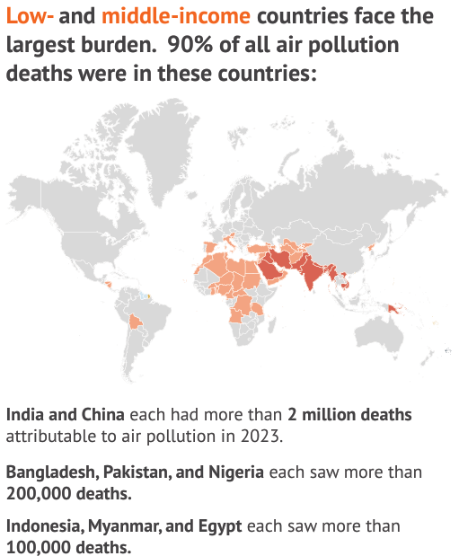
Section 1: Motivation
The Global Crisis of Air Pollution
Air pollution is a multidimensional global crisis particularly critical in rapidly evolving economies like India.
Urbanization and industrialization create complex fluctuations in air quality rather than a steady decline.
There is an urgent need to transition from simple monitoring to "predictive intelligence" to understand future behavior.
https://www.stateofglobalair.org/sites/default/files/documents/2025-10/soga-2025-annual-report-executive-summary-infographic.pdf

Slide 3

Section 1: Motivation
Challenges and Objectives
Challenges: Inconsistency of pollution sources and unique "pollution signatures" during winter/post-monsoon that traditional statistics struggle to categorize.
Core Objective: Conduct a comparative analysis of classical ML models (Multiple Linear Regression, SVM, and Random Forest) to classify seasonal air quality levels.
Goal: Re-emphasize the effectiveness of traditional ML models in an era dominated by deep learning.
Technology | Scope | Description
Machine Learning | Subset of AI | Systems that learn from data without explicit programming
Deep Learning | Subset of ML | Neural networks with multiple layers for complex pattern recognition
https://www.scaler.com/blog/difference-between-machine-learning-and-deep-learning/

Slide 4
Section 2: Literature Review
Paper 1: Optimized Machine Learning Model for Air Quality Index Prediction in Major Cities in India
Proposed Model:
A hybrid machine learning model combining Grey Wolf Optimization (GWO) and Decision Tree regression.
Key Functions:
GWO: Used to select the most important pollutant features.
Decision Tree: Used to predict the final AQI categories.
Data Handling: Used SMOTE to balance the dataset and standard processing for missing values.
Key Findings:
The study achieved high prediction accuracy ranging from 88% to 97%.
PM2.5 and PM10 were identified as the primary pollutants affecting AQI levels.
Critical Analysis:
Strength: Significant accuracy improvements through optimization techniques.
Limitation: Limited seasonal analysis and restricted dataset diversity.
https://www.researchgate.net/publication/379152313
Notes:
Both studies highlight that PM2.5 and PM10 concentrations are the primary drivers for AQI categories and that seasonal variations—particularly in winter and post-monsoon—lead to high variability. These findings justify the use of Support Vector Machines, Random Forest, and regression models in our study.

Slide 5
Section 2: Literature Review
Paper 2 : Seasonal Analysis of Air Pollution in India (Coastal and Non-Coastal Cities)
Methodology:
Utilized LSTM (Long Short-Term Memory) networks to predict AQI values and analyze pollutant trends across different seasons.
Environmental Insights:
Monsoon Season: AQI levels are generally lower as rainfall helps remove pollutants from the air.
Post-Monsoon: Pollution increases significantly due to industrial emissions and crop burning.
Geographical Impact: Coastal areas maintain better air quality than non-coastal cities due to sea breezes dispersing pollutants.
Key Findings:
Confirmed that PM2.5 and PM10 strongly affect AQI across all seasons.
Critical Analysis:
Strength: Effective seasonal comparison of pollution patterns.
Limitation: Limited feature diversity and lack of broad model comparisons.
https://www.researchgate.net/publication/387075271
Notes:
Both studies highlight that PM2.5 and PM10 concentrations are the primary drivers for AQI categories and that seasonal variations—particularly in winter and post-monsoon—lead to high variability. These findings justify the use of Support Vector Machines, Random Forest, and regression models in our study.

Slide 6
Section 3: Dataset Description
Dataset Attributes and Source
Source: Publicly available Kaggle dataset: "India City Air Quality Index Dataset (2015-2023)".
Features: Includes 8 relevant features representing particulate (PM2.5, PM10) and gaseous (NO2, SO2, CO, O3) pollutants.
Target: AQI values and their categorical classifications (Good, Satisfactory, Moderate, Poor).
Data Preprocessing
Cleaning: Handled inconsistent values and validated the relationship between PM2.5 and PM10.
Feature Engineering: Derived a "season" feature from the date column (Winter, Summer, Monsoon, Post-Monsoon).
Standardization: Features were scaled to a mean of 0 and variance of 1 for sensitivity dependent models like SVM.
Exploratory Data Analysis (EDA) Insights
Correlations: Strong positive correlation between PM2.5 and PM10, confirming they are the primary drivers of AQI.
Seasonal Patterns: Average AQI is stable, but extreme pollution spikes are concentrated in winter and post-monsoon periods.
VIF Analysis: Values between 1-5 indicated no severe multicollinearity.

Slide 7
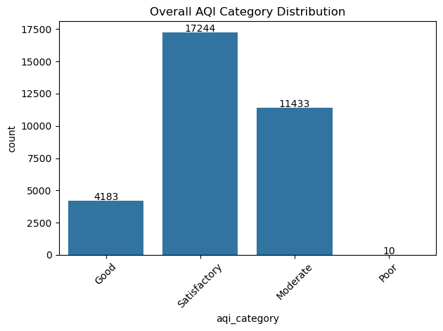
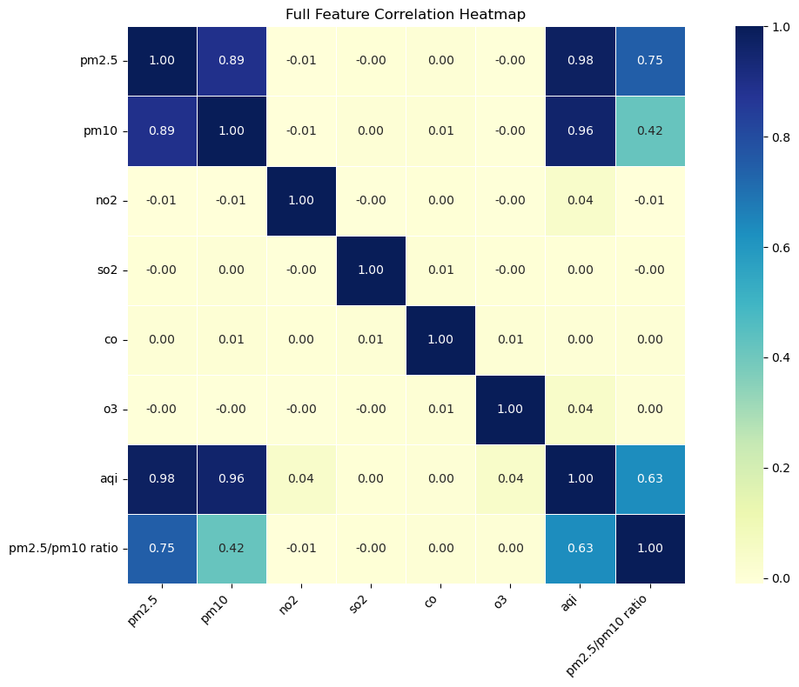
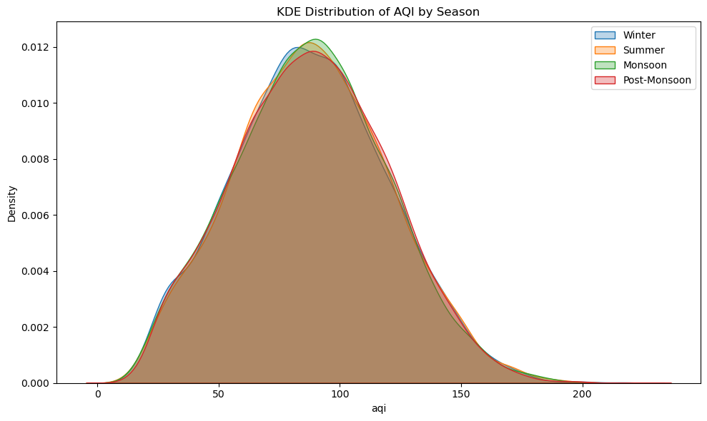
Section 3: Dataset Description

Slide 8
Section 4: Methodology
Model 1 – Multiple Linear Regression (MLR)
Core Logic:
A parametric approach that assumes a linear relationship between pollutants (PM2.5, NO2, etc.) and the numerical AQI value.
The "Weighted" Innovation:
Standard regression often ignores outliers or minority classes.
We implemented a Weighted Least Squares approach, assigning weights up to 3000 for "Poor" air quality days to ensure the model prioritizes accuracy during high-pollution events.
Regression-to-Classification Pipeline:
The model first predicts a precise numerical AQI.
This value is then "bucketed" into categories (Good, Satisfactory, Moderate, Poor) based on CPCB (Central Pollution Control Board) regulatory thresholds.
Why it works:
It captures the subtle gradients in pollution levels before forcing them into rigid categories.

Slide 9
Section 4: Methodology
Model 2 – Random Forest (RF)
Ensemble Power:
Random Forest functions as a "wisdom of the crowd" algorithm, building multiple independent decision trees and combining their results through majority voting.
Feature Prioritization:
The model identified PM2.5 and PM10 as the most significant predictors of AQI.
By focusing on these "heavy hitters," the model reduces noise and improves classification speed.
Hyperparameter Tuning:
We used Accuracy vs. Number of Trees plots to find the "sweet spot" where the model is most accurate without becoming slow or overfitted.
Robustness:
This ensemble approach is naturally resistant to outliers and handles the non-linear seasonal fluctuations of air quality more effectively than single-tree models.

Slide 10
Section 4: Methodology
Model 3 – Support Vector Machine (SVM)
RBF Kernel Integration:
We used the Radial Basis Function (RBF) kernel, which allows the model to create complex, non-linear boundaries to separate air quality classes that aren't easily split by a straight line.
Data Strategy (Class Merging):
The "Poor" category was underrepresented with only 10 instances.
To prevent the model from ignoring this critical class, we merged it into the "Moderate" category to create a more balanced and trainable dataset.
Dimensionality Reduction (PCA):
Since our data has 8 features, it is impossible to visualize in 3D.
We used Principal Component Analysis (PCA) to compress the data into two dimensions, allowing us to plot and verify the model’s decision boundaries visually.
Evaluation:
Focused on the Macro F1-score to ensure the model performed well across all categories, not just the most common ones.

Slide 11
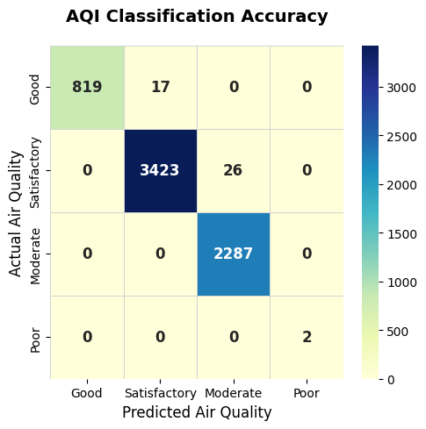
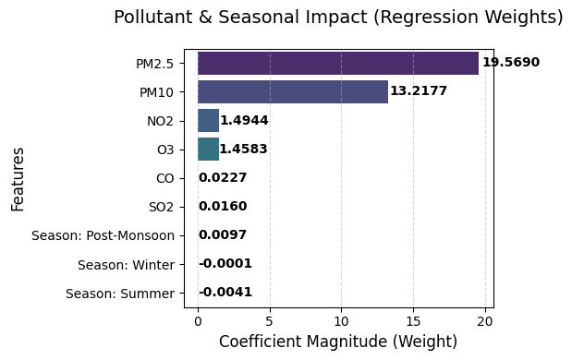
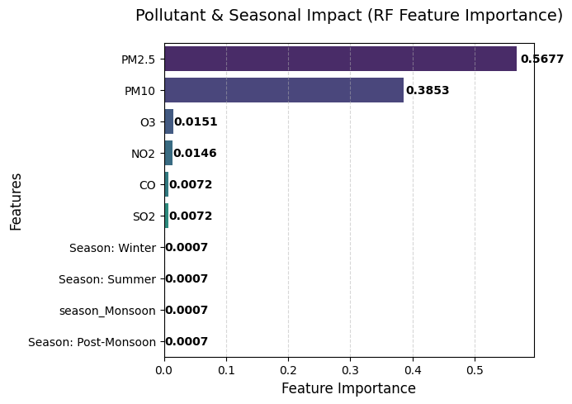
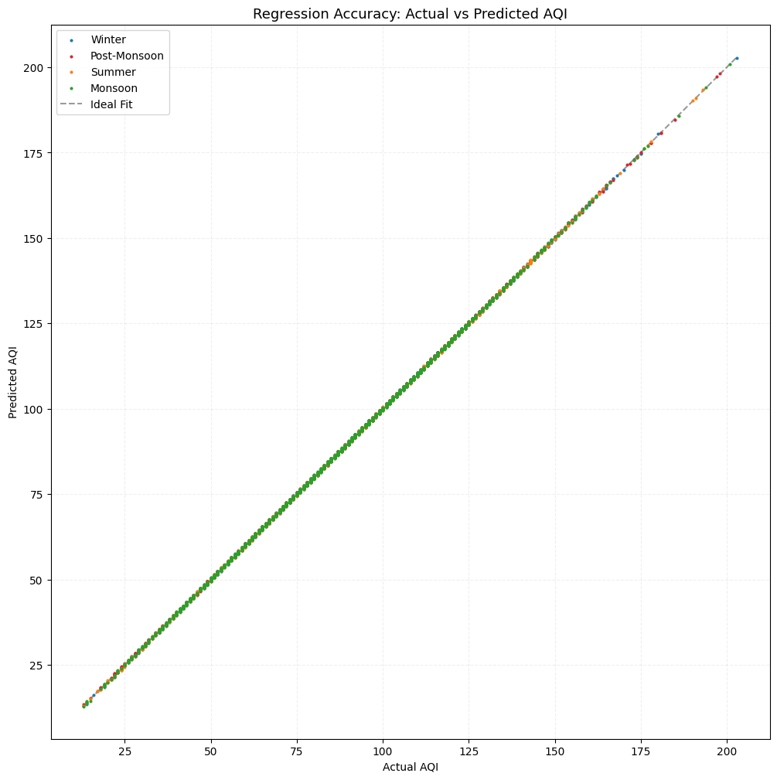
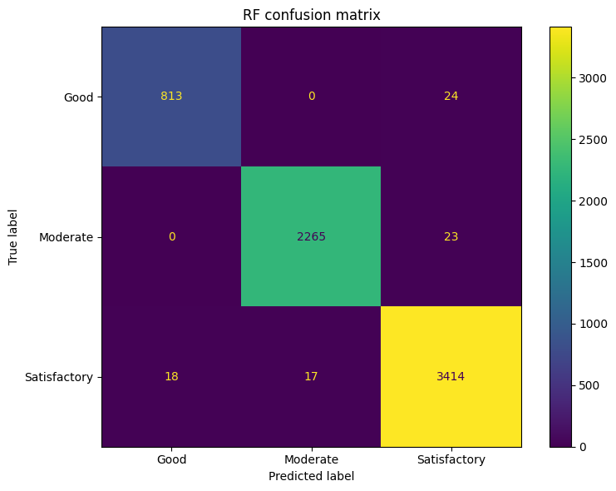
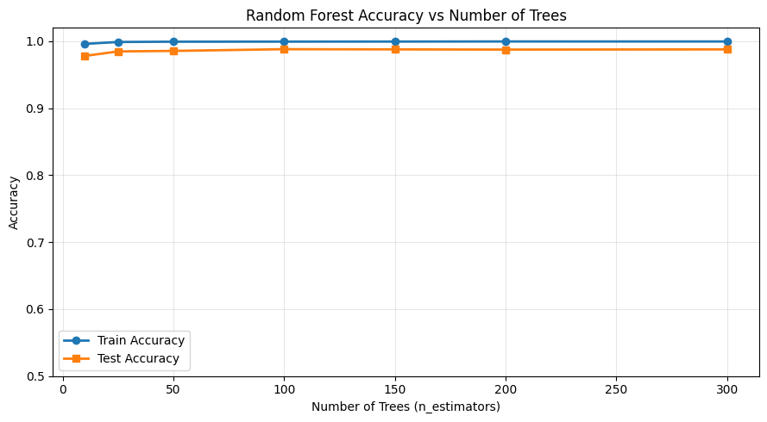
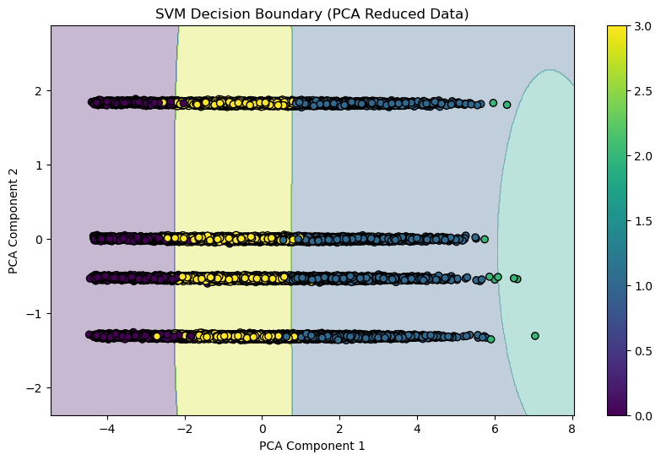
Section 4: Methodology
Multiple Linear Regression
Random Forest .
Support Vector Machines .

Slide 12
Section 5: Results, Analysis & Conclusion
Performance Results and Model Comparison
High Accuracy Across Models: All three models achieved accuracy levels greater than 98%, attributed to effective feature selection and a high-quality dataset with no missing values.
Performance Metrics Table:
Multiple Linear Regression (MLR): 99.3% Accuracy, 0.99 Macro F1, 0.99 Kappa.
Support Vector Machine (SVM): 98.4% Accuracy, 0.98 Macro F1, 0.97 Kappa.
Random Forest (RF): 98% Accuracy, 0.98 Macro F1, 0.97 Kappa.
Analysis of MLR: Although MLR showed the highest numerical accuracy, it uses an indirect approach (predicting raw AQI then mapping to categories), making it less suitable for direct classification compared to SVM and RF.

Slide 13
Section 5: Results, Analysis & Conclusion
Feature Ablation and Final Conclusion
Feature Ablation Results: When the primary drivers (PM2.5 and PM10) were removed, the SVM model showed only a slight drop in performance, demonstrating superior robustness and the influence of correlated features.
Model Selection: SVM was selected as the best overall model due to its consistent performance across all metrics, strong generalizing ability, and robust nature under feature ablation.
Key Takeaway: While regression-based approaches are suitable for lightweight tasks, direct classification models like SVM and RF provide more meaningful and stable results for critical environmental analysis.

Slide 14
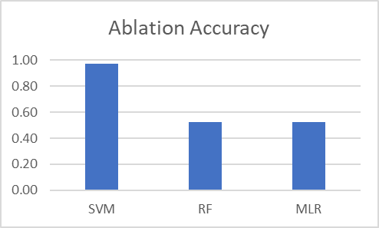
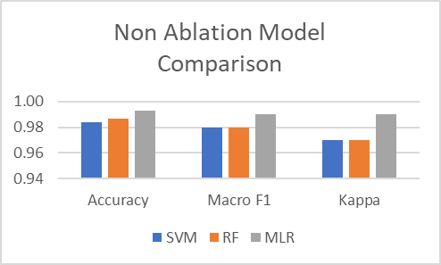
Section 5: Results, Analysis & Conclusion
Model | Accuracy | Macro F1 | Kappa | CV Score | Train-Test Gap
SVM | 98.4% | 0.98 | 0.97 | High | Low
RF | 98% | 0.98 | 0.97 | Stable | Slight
MLR | 99.3% | 0.99 | 0.99 | Very High | Very Low

Slide 15
Section 6: Future Works
Future Research Directions
Expanded Feature Set: Incorporate additional meteorological parameters such as temperature, humidity, and wind speed to further enhance predictive accuracy.
Advanced Modeling: Explore hyperparameter optimization, ensemble learning, and deep learning architectures to improve predictive ability.
Practical Application: Implement the model as a web or mobile application, utilizing real-time data fetched through APIs for practical public use.
Dataset Generalization: Conduct deeper analysis using larger and more diverse datasets to improve the model's applicability to varied real-world geographical situations.

Slide 16
Section 7: Team Contributions
Farhan Akhlaq
SVM Implementation: Developed the Support Vector Machine (SVM) model utilizing an RBF kernel for classification.
Dimensionality Reduction: Applied Principal Component Analysis (PCA) to visualize high-dimensional classification boundaries in 2D.
Metrics Analysis: Executed final performance evaluations using standardized project metrics.
Karthik Baurai
Feature Engineering: Engineered seasonal features and handled multi-city data aggregation to identify temporal patterns.
Exploratory Data Analysis: Conducted statistical evaluations (skewness/kurtosis) and correlation analysis for pollutant behaviors.
Model Optimization: Handled data consistency and assisted in Random Forest implementation.
Misbah Ul Islam
Random Forest Development: Led the development of the Random Forest classifier, utilizing ensemble learning to improve accuracy.
Performance Validation: Conducted cross-validation and confusion matrix analysis to ensure model reliability and prevent overfitting.
Literature Review: Researched and documented the environmental context and existing methodologies for air quality prediction.
Mukund Prasad
Data Infrastructure: Managed the raw 2015–2023 AQI dataset, cleaning workflows, and preprocessing documentation.
Deep Statistical EDA: Performed rigorous data validation, including Multicollinearity (VIF) checks and physical constraint verification.
ML Pipeline & Interface: Built the Multiple Linear Regression (MLR) workflow and a CLI-style prediction interface with input validation.

